Slide 1
Microcontroller Interfaces SPI and I2C
RBE500-F17-10-04
Adj. Prof. Julian Center

Slide 2
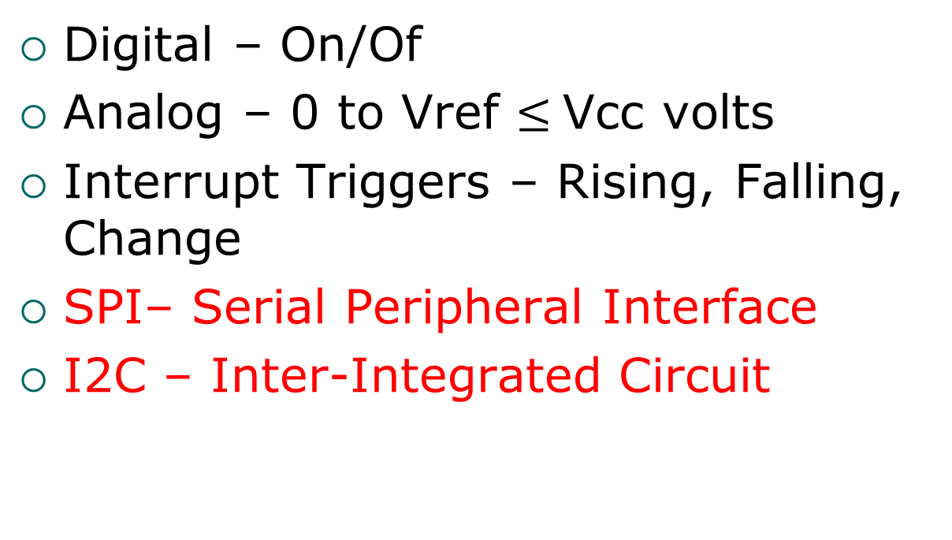
Relatively Low Speed Interfaces Between Microcontrollers and Peripherals
Digital – On/Of
Analog – 0 to Vref $≤$Vcc volts
Interrupt Triggers – Rising, Falling, Change
SPI– Serial Peripheral Interface
I2C – Inter-Integrated Circuit
http://www.byteparadigm.com/applications/introduction-to-i2c-and-spi-protocols/

Slide 3
SPI Overview
Grew out of popular Motorola 68000 microprocessor architecture around 1979.
No detailed formal description. Can vary with microcontroller and peripheral.
4 wire interface. Requires one extra microcontroller pin per peripheral.

Slide 4
SPI Signals
SCLK – clock sent by the bus master to all slaves. All SPI signals are synchronized to this clock.
SSn – Slave select signal for each peripheral.
MOSI – (Master Out Slave In) Data communication from master to slave.
MISO – (Master In Slave Out) Data communication from slave to master.

Slide 5
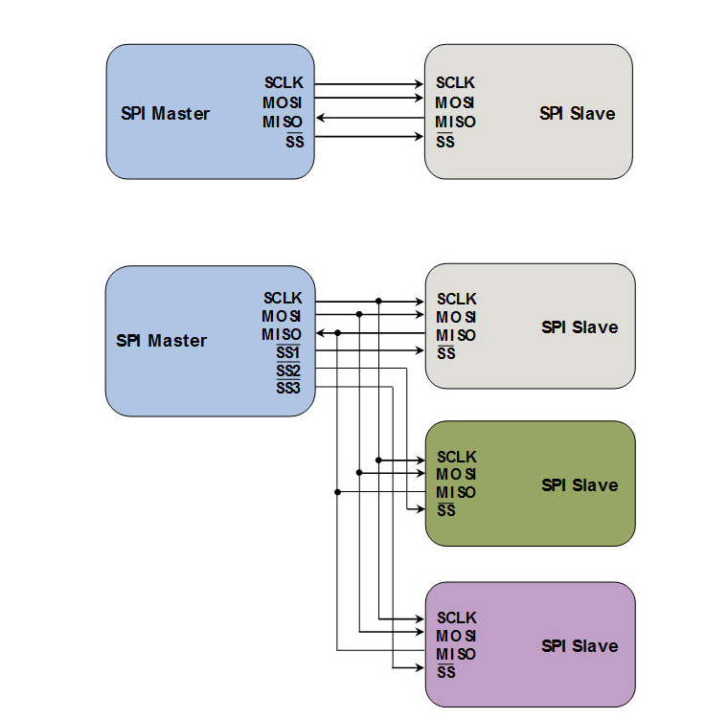
SPI Interconnections
Single Peripheral
Multiple Peripherals

Slide 6
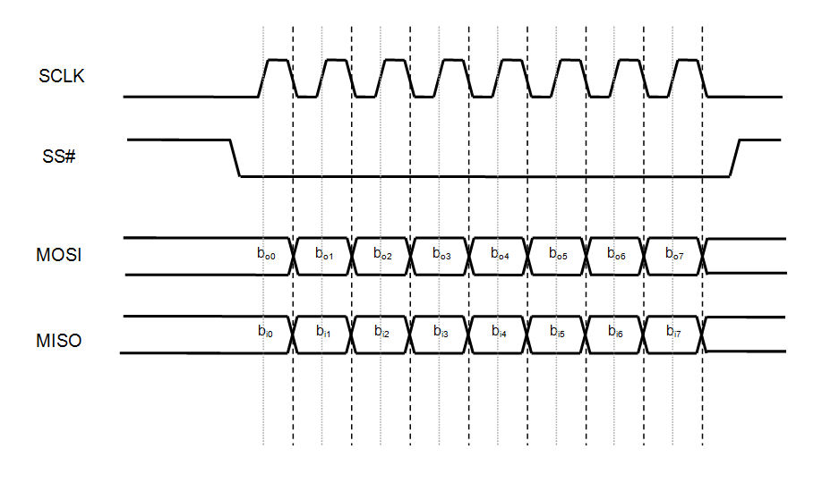
SPI Signal Relationships

Slide 7
Toggling and Sampling Options
Data Toggling (changing data) and Data Sampling can be varied.
Option must be negotiated between master and slave.
Master may have to change modes between talking to multiple peripherals.

Slide 8
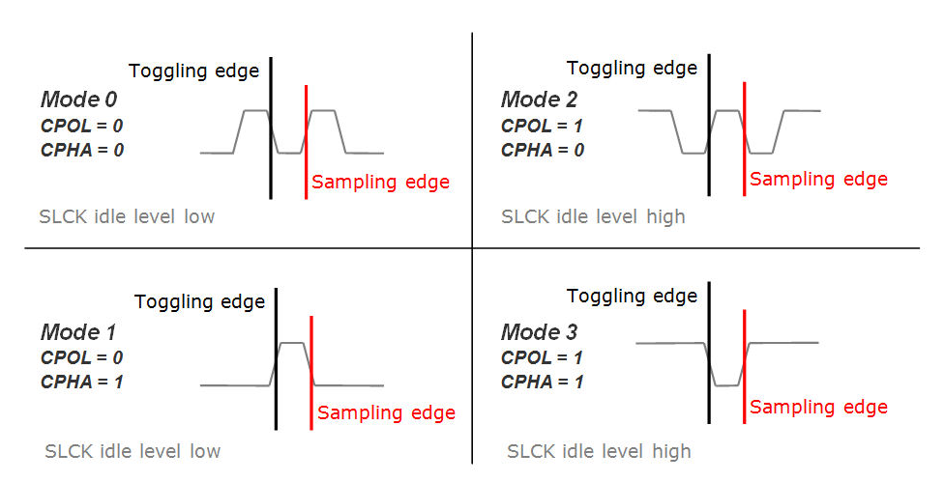
SPI Toggling and Sampling Options

Slide 9
SPI Characteristics
Single master system, usually the microcontroller.
Can be used to communicate between multiple microcontrollers, but only one must be master.
Full-Duplex communication. Both master and slave can send data at the same time.

Slide 10
I2C (I²C) Overview
Developed by Phillips Labs in Eindhoven, Netherlands in 1982.
Well documented and controlled specification, continually improved.
Uses only 2 wires for one or many peripherals.
Can have multiple masters.
Open drain communications prevent conflicts. Pull to ground to send zero. Otherwise one.

Slide 11
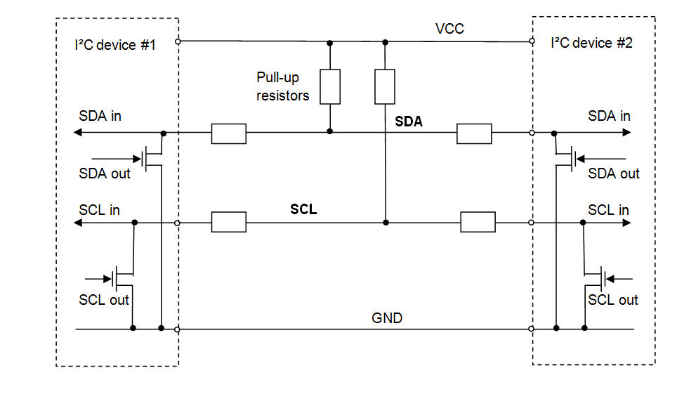
I2C Interconnections

Slide 12
SPI Signal Protocol (1)
Master sends peripheral address code and read/write bit.
Message is initiated by master sending a unique start signal.
All peripherals listen for their address.
Peripheral that was addressed sends acknowledge signal.

Slide 13
SPI Signal Protocol (2)
Data transmission begins in byte multiples.
Data can change only on SDA line when SCL clock is low.
Data is considered valid when SCL is high.
After transmission, master sends unique stop signal, which releases the bus.

Slide 14
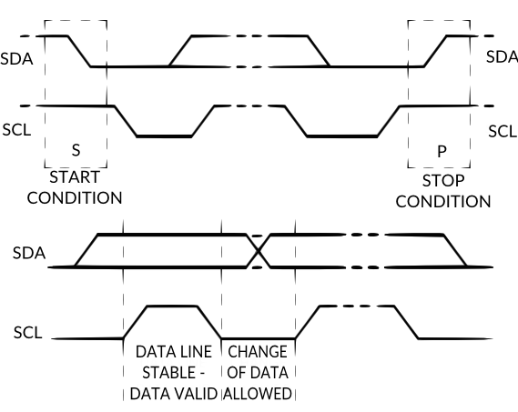
I2C Start and Stop Conditions

Slide 15
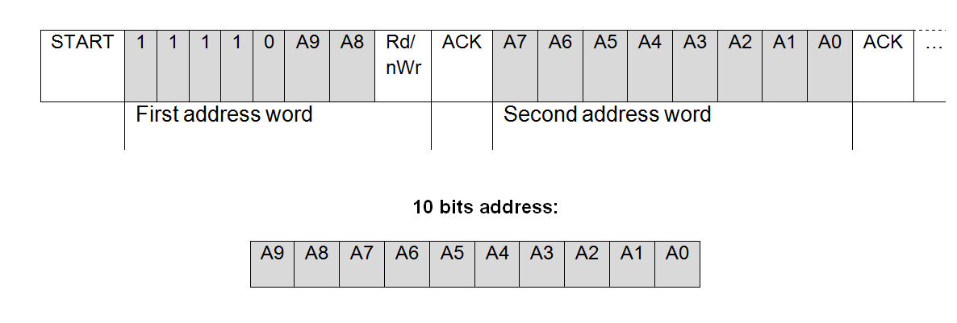
I2C Extended Addressing
o Normal I2C address is 7 bits
o Most peripherals allow two possible addresses by hardware jumper change.
o Some peripherals can utilize and extended 10 bit address

Slide 16
SPI Data Rates
Standard data rates are 100kbps (standard mode), 400kbps (fast mode), and 3.4 Mbps (high speed mode).
Some variants have 10kbps (low speed mode) and 1 Mbps (fast mode +)

Slide 17
Comparison of SPI and I2C
Pins used
SPI uses at least 4 microcontroller pins and one more for each extra peripheral.
I2C uses only 2 pins for typically up to 16 peripherals due to bus loading, but more are possible by expansion chips.
Data Speed
SPI can be much faster than I2C and is full duplex. At least 10Mbps. Often used to connect two controllers.

